Slide 1
Conditioned Chinese Poetry Generation
apple

Slide 2
Table of Contents
Background
Our Model (BTP)
Datasets
Experimental Results
Conclusion

Slide 3
Background

Slide 4
Chinese poetry writing
《蕙风词话》：“吾观风雨，吾览江山，常觉风雨江山之外，别有动吾心者”
Emotional Feeling + Format/Rhyme→Poetry
Background B：
九月十五日的扬州旅舍，在一个月明星稀的夜晚，诗人抬望天空一轮皓月，思乡之情油然而生。
Format and Rhyme Label Sequence C：
（how long is each sentence，rhyme class, etc）
床前明月光，疑是地上霜。举头望明月，低头思故乡。

Slide 5
Related Works
Traditional Machine Poetry Writing
Template-based methods、Statistical machine learning methods（genetic algorithms、statistical machine translation）
Neural Network-Based Poetry Writing
（1）Enhance the fluency and rhyme of poetry
RNN、Polish models
（2） Disentangling different styles (types) of poetry corresponding to the different distribution of hidden variables
often use VAE
（3）Conditioned poetry generation
WM（keyword + format + rhyme class），Transformer-based（topic + format）， Transformer-based（format and rhyme label sequence）

Slide 6
Our task
To let modern people express their motivation in beautiful poems
This kind of motivation can be: the latest experience, the present mood, the vision of the future, and even the life experience
Background B：
九月十五日的扬州旅舍，在一个月明星稀的夜晚，诗人抬望天空一轮皓月，思乡之情油然而生。
Format and Rhyme Label Sequence C：
（how long is each sentence，rhyme class, etc）
床前明月光，疑是地上霜。举头望明月，低头思故乡。
Challenge?

Slide 7
Challenge
Difference between modern and ancient poetry expressions
Very few background or translation train data
Background B：
九月十五日的扬州旅舍，在一个月明星稀的夜晚，诗人抬望天空一轮皓月，思乡之情油然而生。
Format and Rhyme Label Sequence C：
（how long is each sentence，rhyme class, etc）
床前明月光，疑是地上霜。举头望明月，低头思故乡。

Slide 8
Our Model

Slide 9
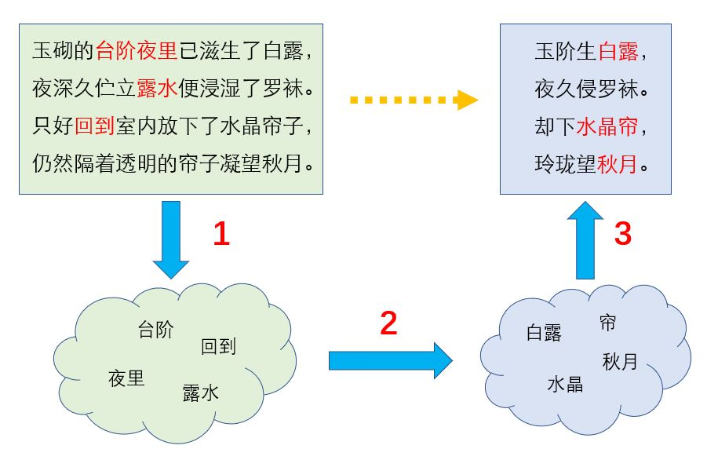
Overview
Vernacular 白话文
We propose BTP model（Background To Poetry）
Three steps：
（1）Obtain vernacular keywords
（2） find the corresponding poetry keywords
（3）According to the obtained poetry keywords and metrical label, generates ancient poems

Slide 10
Obtaining vernacular keywords
Tokenize the creative background
According to the importance weight of the vernacular vocabulary, select the vernacular keywords with highest weights
The importance weights are trained by TextRank on the vernacular corpus

Slide 11
Obtaining poetry keywords
Two approaches：
（1）co-occurrence matrix
（2）transformation matrix
How to use these two approaches?
Input a vernacular keyword, the result is the correlation score between the vernacular keyword and each poetry keyword

Slide 12
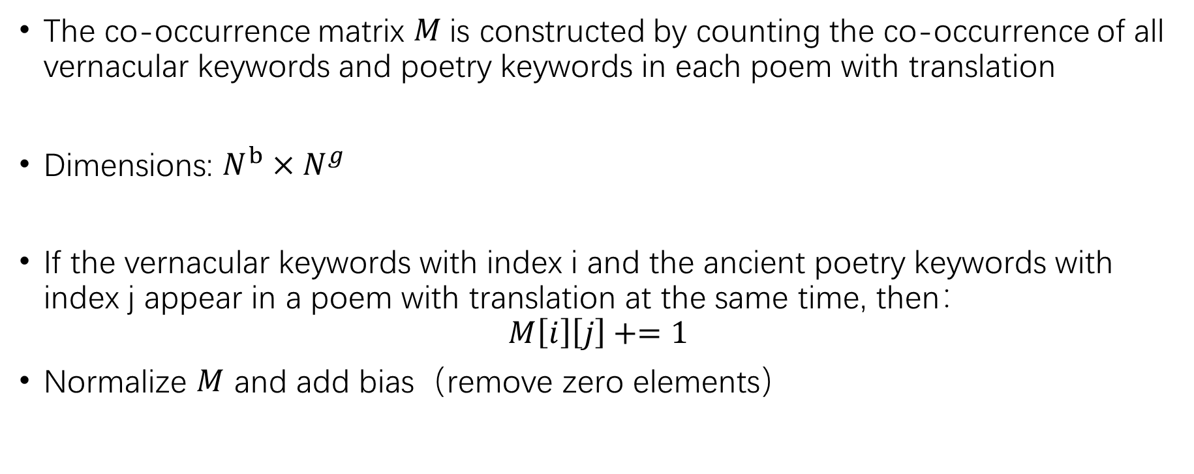
Obtaining poetry keywords（co-occurrence）
The co-occurrence matrix $M$is constructed by counting the co-occurrence of all vernacular keywords and poetry keywords in each poem with translation
Dimensions: $N^{b}×N^{g}$
If the vernacular keywords with index i and the ancient poetry keywords with index j appear in a poem with translation at the same time, then：
$$M\left[i\right]\left[j\right]+=1$$
Normalize $M$ and add bias（remove zero elements）

Slide 13
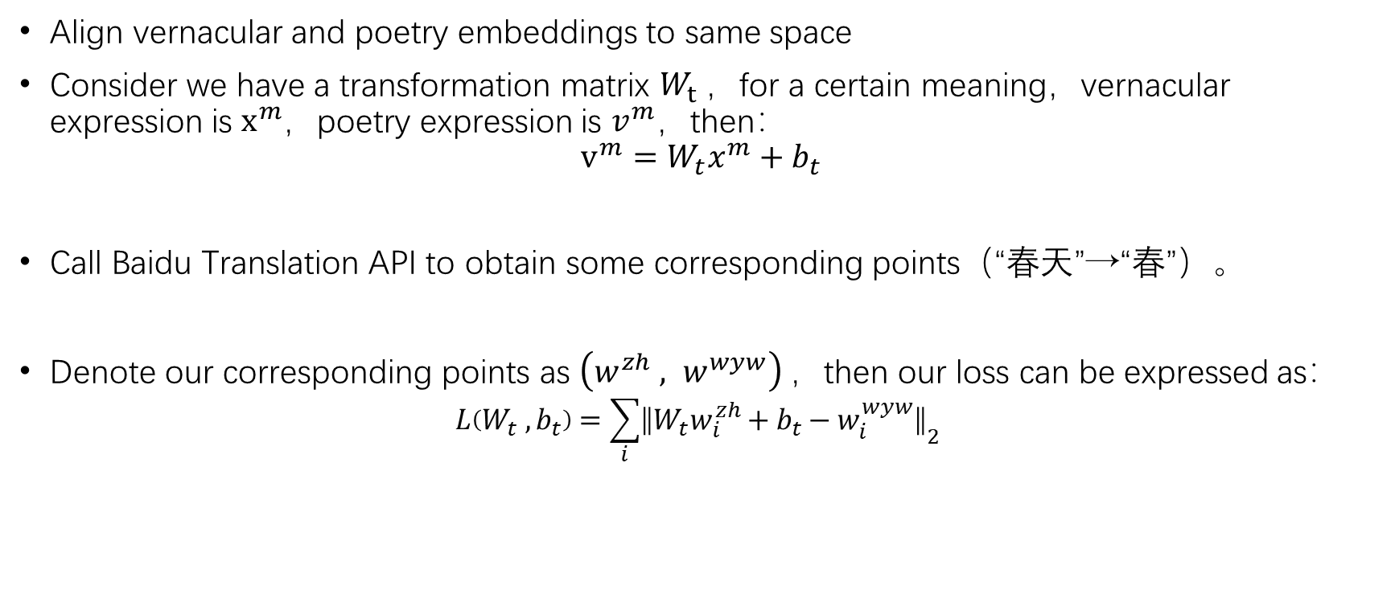
Obtaining poetry keywords（transformation）
Align vernacular and poetry embeddings to same space
Consider we have a transformation matrix $W_{t}$，for a certain meaning，vernacular expression is $x^{m}$，poetry expression is $v^{m}$，then：
$$v^{m}=W_{t}x^{m}+b_{t}$$
Call Baidu Translation API to obtain some corresponding points（“春天”→“春”）。
Denote our corresponding points as $\left(w^{zh} , w^{wyw}\right)$，then our loss can be expressed as：
$$L\left(W_{t} ,b_{t}\right)=\sum_{i}{{\left\|W_{t}w_{i}^{zh}+b_{t}−w_{i}^{wyw}\right\|}_{2}}$$
T
“春”

Slide 14

Poetry Decoder
Transformer-based auto-regressive model
Chinese character→token
The embedding labels we defined are：
（1）format and rhyme label C
（2）intra-position label P
（3）segment label S
Final embedding of a token：
$$H_{t}^{0}=E_{w_{t}}+E_{c_{t}}+E_{p_{t}}+E_{s_{t}}+E_{g_{t}}$$

Slide 15
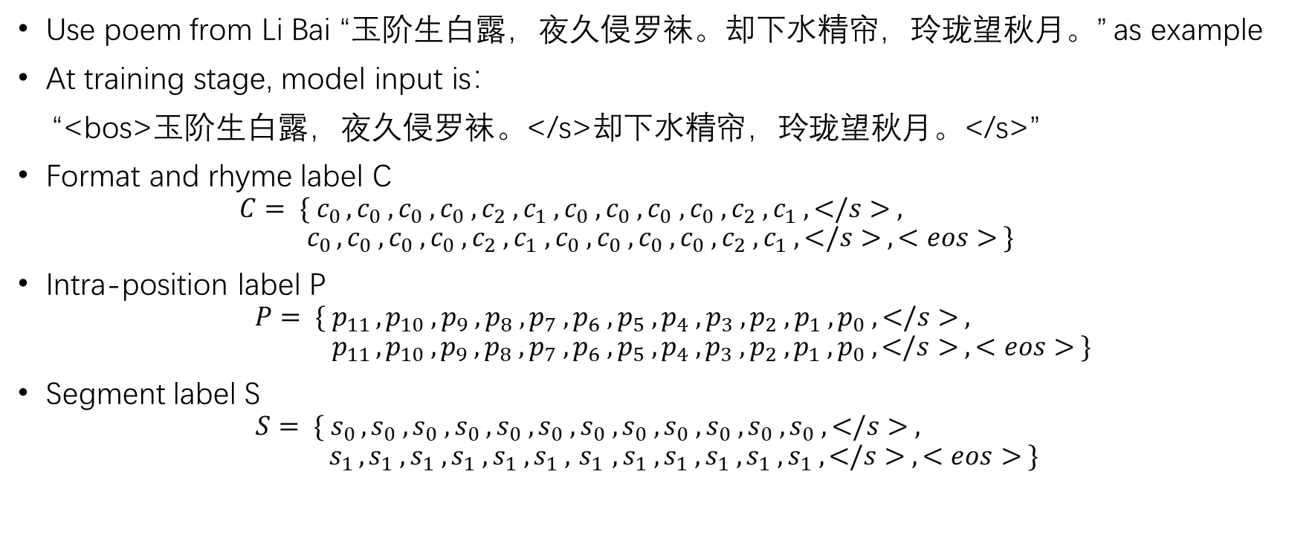
Poetry Decoder（embedding labels）
Use poem from Li Bai “玉阶生白露，夜久侵罗袜。却下水精帘，玲珑望秋月。” as example
At training stage, model input is：
“<bos>玉阶生白露，夜久侵罗袜。</s>却下水精帘，玲珑望秋月。</s>”
Format and rhyme label C
$$C= {\{ c}_{0 }, c_{0} ,c_{0} ,c_{0} ,c_{2} ,c_{1} ,c_{0} ,c_{0} ,c_{0} ,c_{0} ,c_{2} ,c_{1} , </s> , c_{0 }, c_{0} ,c_{0} ,c_{0} ,c_{2} ,c_{1} ,c_{0} ,c_{0} ,c_{0} ,c_{0} ,c_{2} ,c_{1} , </s> , <eos> \}$$
Intra-position label P
$$P= {\{ p}_{11 }, p_{10} ,p_{9} ,p_{8} ,p_{7} ,p_{6} ,p_{5} ,p_{4} ,p_{3} ,p_{2} ,p_{1} ,p_{0} , </s> ,$$
$${ p}_{11 }, p_{10} ,p_{9} ,p_{8} ,p_{7} ,p_{6} ,p_{5} ,p_{4} ,p_{3} ,p_{2} ,p_{1} ,p_{0} , </s> , <eos> \}$$
Segment label S
$$S= {\{ s}_{0 }, s_{0} ,s_{0} ,s_{0} ,s_{0} ,s_{0} ,s_{0} ,s_{0} ,s_{0} ,s_{0} ,s_{0} ,s_{0} , </s> ,$$
$${ s}_{1 }, s_{1} ,s_{1} ,s_{1} ,s_{1} ,s_{1} , { s}_{1} ,s_{1} ,s_{1} ,s_{1} ,s_{1} ,s_{1} , </s> , <eos> \}$$

Slide 16
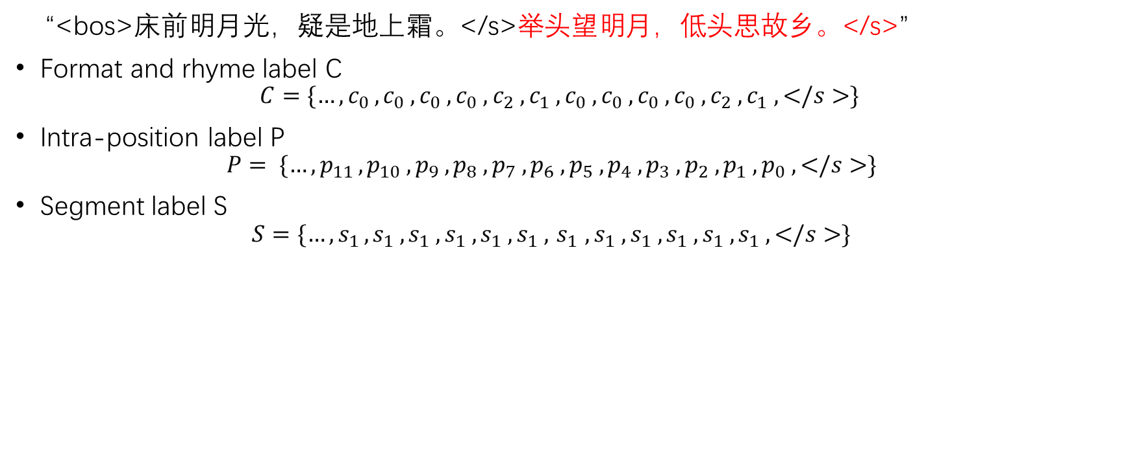
Quiz
“<bos>床前明月光，疑是地上霜。</s>举头望明月，低头思故乡。</s>”
Format and rhyme label C
$$C=\{…, c_{0 }, c_{0} ,c_{0} ,c_{0} ,c_{2} ,c_{1} ,c_{0} ,c_{0} ,c_{0} ,c_{0} ,c_{2} ,c_{1} , </s>\}$$
Intra-position label P
$$P= {\{…, p}_{11 }, p_{10} ,p_{9} ,p_{8} ,p_{7} ,p_{6} ,p_{5} ,p_{4} ,p_{3} ,p_{2} ,p_{1} ,p_{0} , </s>\}$$
Segment label S
$$S={\{…, s}_{1 }, s_{1} ,s_{1} ,s_{1} ,s_{1} ,s_{1} , { s}_{1} ,s_{1} ,s_{1} ,s_{1} ,s_{1} ,s_{1} , </s>\}$$

Slide 17
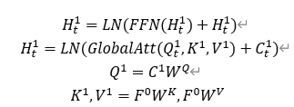
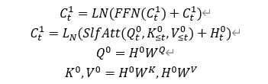
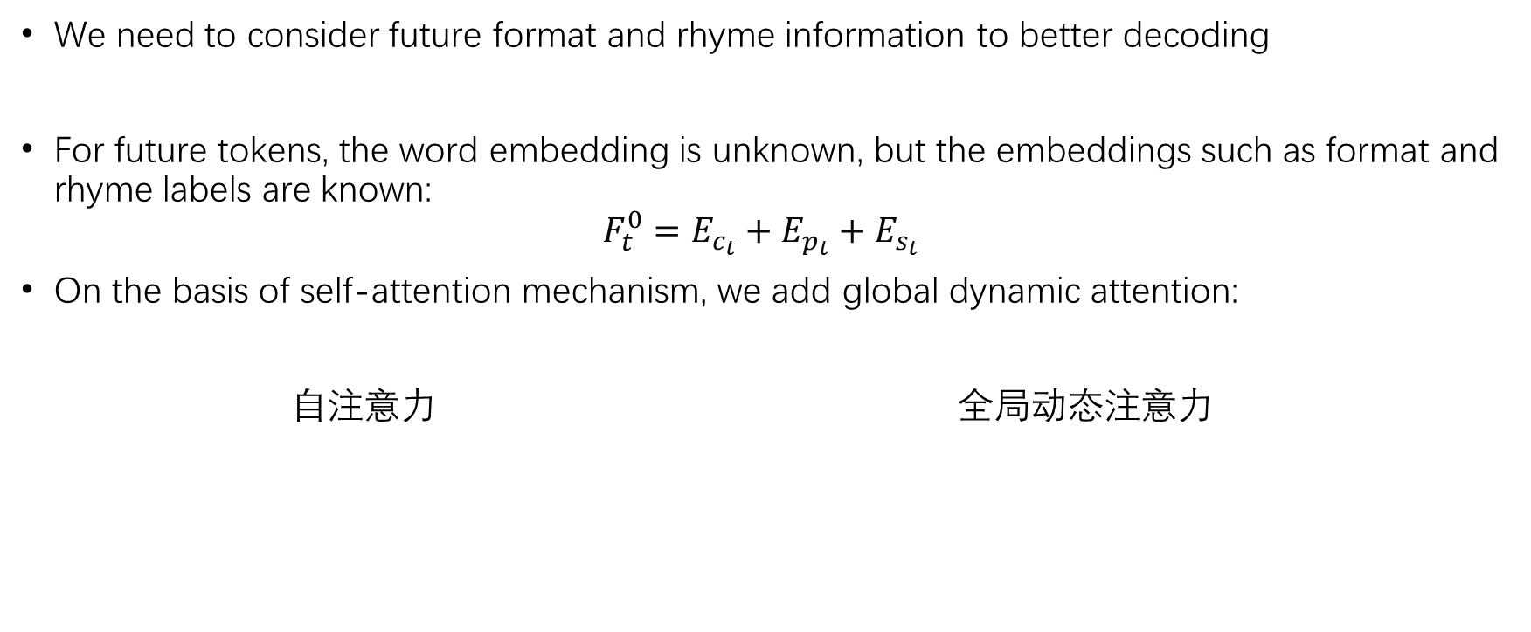
Poetry Decoder （global dynamic attention）
We need to consider future format and rhyme information to better decoding
For future tokens, the word embedding is unknown, but the embeddings such as format and rhyme labels are known:
$$F_{t}^{0}=E_{c_{t}}+E_{p_{t}}+E_{s_{t}}$$
On the basis of self-attention mechanism, we add global dynamic attention:
自注意力 全局动态注意力
Self-attention
Global dynamic attention

Slide 18

Poetry Decoder （keyword input）
Inport keyword information in the global dynamic attention module. Because keywords, just like format and rhyme labels, are visible in the whole process of poetry generation
Append to the front of $F_{t}$, separate by seperator

Slide 19
Datasets

Slide 20

Poetry Datasets
Gushiwen Dataset
2178 poems，1302 has creative background
XiChuangZhu Dataset
580936 poems with good format
2614 with translation

Slide 21
Keywords
Vocabulary
Tokenize with JieBa, remove stop words
29849 poetry keywords，9498 vernacular keywords
Importance score
TextRank method，input keyword sequence
Word embedding
Vernacular: pretrained glove vectors
Poetry: train a glove

Slide 22
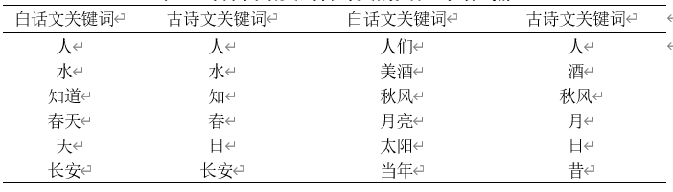
Corresponding points
Call Baidu API（vernacular→wenyanwen）
7036 corresponding points

Slide 23
Experimental Results

Slide 24
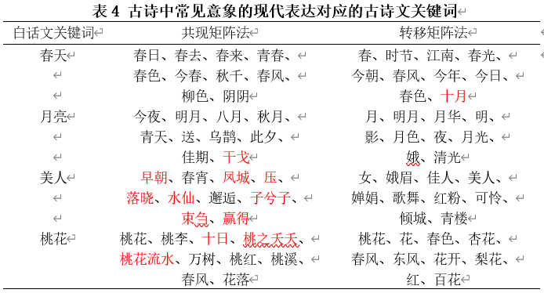
Vernacular keywords→poetry keywords
Modern expression of common images in ancient poems

Slide 25
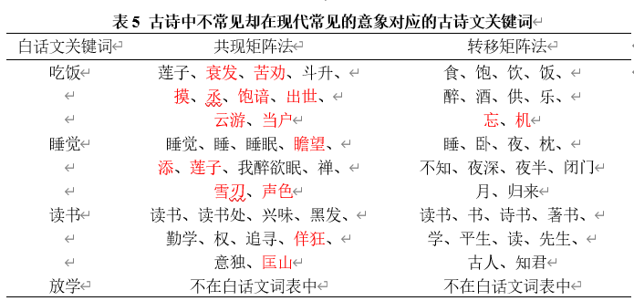
Vernacular keywords→poetry keywords
Images that are not common in ancient poetry but common in modern expression

Slide 26
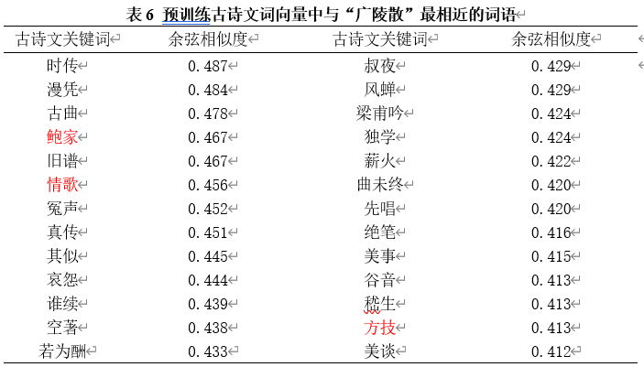
Vernacular keywords→poetry keywords
Images that are not common in ancient poetry but common in modern expression

Slide 27
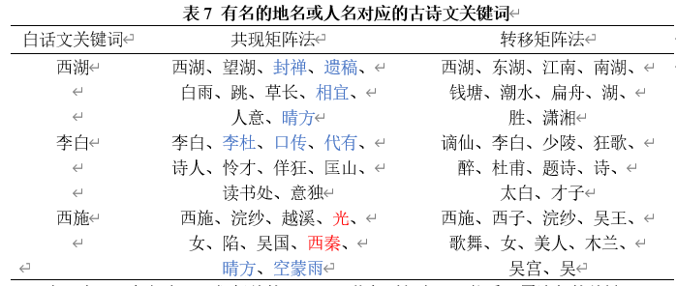
Vernacular keywords→poetry keywords
Famous name or place

Slide 28
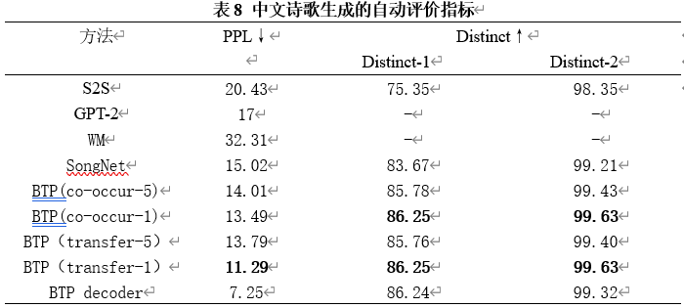
Conditioned Poetry Generation
Can we reduce perplexity and maintain(or improve) diversity by combining the background and rhyme of poetry creation at the same time?

Slide 29
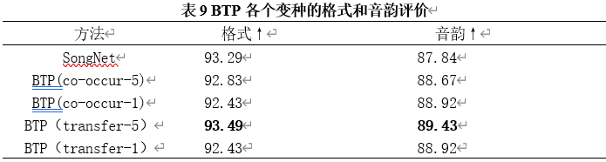
Conditioned Poetry Generation
After combining the background information, will it reduce the performance of the decoder in format and rhyme?

Slide 30
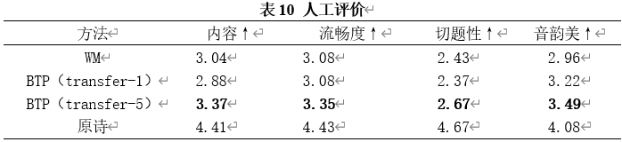
Human evaluation
Input both the creation background and rhyme, evaluate the four aspects of the generated poetry:
（1） Content: is the content empty, broad, and obscure
（2） Fluency: the fluency of poetry generation
（3） Relevance: whether it conforms to the connotation expressed by the user's input creation background
（4） rhyme: whether the generated poetry rhymes and is it catchy to read?

Slide 31
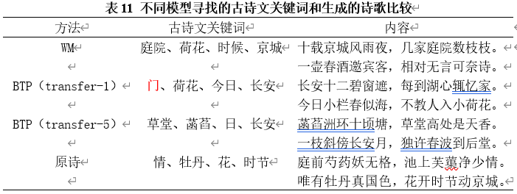
Human evaluation
The words with the highest similarity are not necessarily the best in poem writing
Possibly corresponding points（“享受”→“食”、“吃饭”→“食”）

Slide 32
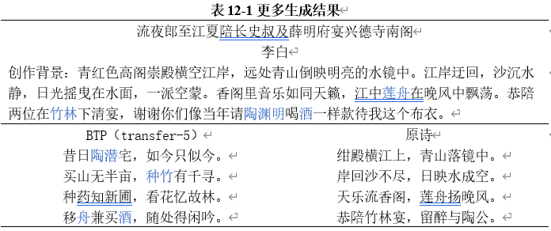
More results

Slide 33
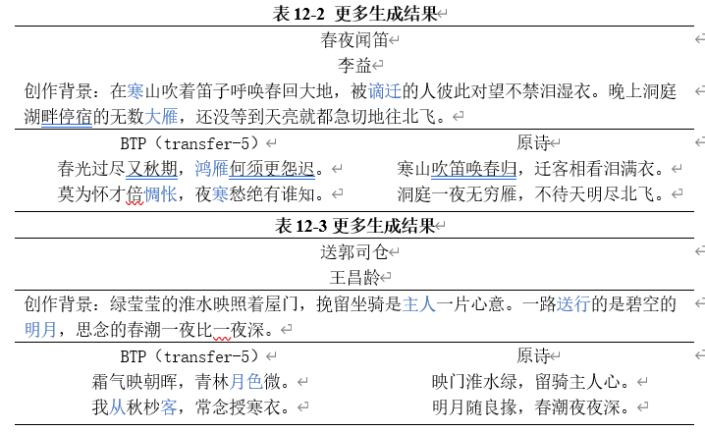
More results

Slide 34
Conclusion

Slide 35
Conclusion
Task
Poetry output not only conform to the given format and rhyme label, but also express people’s own experience, mood, or writing motivation
Datasets
XiChuangZhu Dataset、Gushiwen Dataset
Approach
Three-step BTP
Results
Combining conditions effectively, reducing perplexity and maintaining diversity.
In the comparison of the same task, the content and fluency are slightly improved, and the music beauty is greatly improved.
Future work
Vernacular kw set→poetry kw set
modeling of emotional tone
addition to vernacular vocabulary，combined with social network language words

Slide 36
Thank you for listening

